Slide 1
Some background
Unconstrained optimization
Constrained optimization

Slide 2
Hessian matrices
Hessian matrices are used in large-scale optimization problems within Newton-type methods because they are the coefficient of the quadratic term of a local Taylor expansion of a function. That is,
y = f ( x + Δ x ) ≈ f ( x ) + ∇ f ( x ) ^{T} Δ x + 1/( 2 !)
(Δ x) ^{T} H ( x ) (Δ x)
where ∇f is the gradient (∂f/∂x₁, ..., ∂f/∂x_{n}).
Notes:
找到gradient F(x)=0的位置去推論

Slide 3
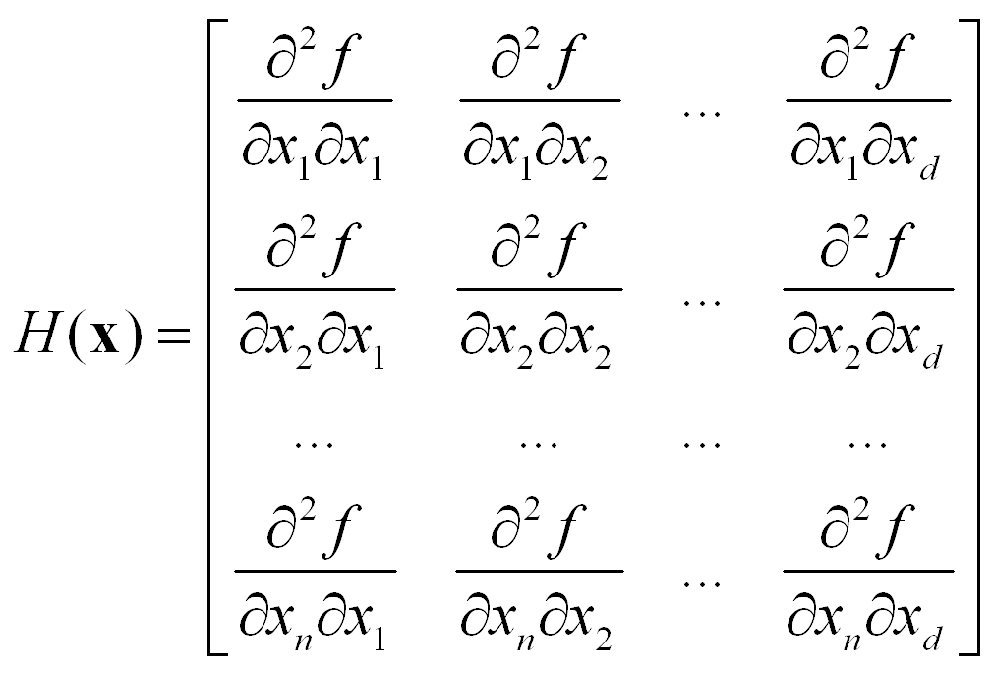
Notes:
偏微分
Partial of x

Slide 4
Example 1: f(x, y) = 3x²+ 2y³- 2xy
The condition to find the max. or min. are:
Whose solution is x*=y*=0 or x*=1/27, y*=1/9
Notes:
找最大最小直的條件
對f微分X 或 Y

Slide 5
The Hessian of f is
At x=y=0
Since [x,y]H(0,0)[x, y]^{T} =6x²-4xy =2x(3x-2y), which can be positive or negative, the Hessian is indefinite and (0,0) is a saddle point.
Notes:
12y 是對y 再次作微分
Saddle point

Slide 6
At x=1/27, y=1/9,
Since [x,y]H(1/27, 1/9)[x,y]^{t} =4x²-2xy+4y²/3=4(x-4y)² +13y²/12 >0, for non-zero x and y, the Hessian is positive definite. Therefore, (1/27, 1/9) is a minimum point. The min. value of f is
-0.0014.
Notes:
非線性最佳化
一階微分得到極值
二階微分得到最大值

Slide 7
Constrained optimization
Equality constraints
find minimum value of f(x1, x2, …, xd) subjected to equality constraints of the form:
g_{i}(x) = 0 , i= 1,2,…, p
A method known as Lagrange multipliers can be used to solve the constrained optimization. This method involves the following steps:
Define the Lagrangian, L(x, λ) = f(x) +
where λ_{I} is a dummy variable called the Lagrange multiplier.

Slide 8
2. Set the first-order derivatives of the Lagrangian with respect to x and the Lagrange multipliers with respect to x to zero,
and
3. Solve the (d+p) equations in step 2 to obtain the stationary point x* and the corresponding values for _{I}’s

Slide 9
Example E.2
Let f(x, y) = x+2y. Suppose we want to minimize the function f(x, y) subject to the constraint
x² + y² -4=0.
First , introduce the Lagrangian
then

Slide 10
Solving these equations yields:
When =
When  = -
Therefore, f(x,y) has its minimum value at
Notes:
問號是lamda

Slide 11
Inequality constraints:
finding the minimum value of f(x1,x2,…,xd) subjected to inequality constraints of the form:
Let
similar approach but more conditions known as the
Karush-Kuhn-Tucker (KKT) conditions:
Notes:
拉格朗日方法 作為 非線性最佳化 很重要的一個方法
設一個L線性 並把lamda 放入 最後再把L微分X…

Slide 12
Example E.3
Want to minimize the function f(x, y) = (x-1)²+(y-3)², subjected to
Lagrangian for this problem:
KKT:

Slide 13
Based on E.19 and E.20, we have four cases:
Case 1: ₁=0, ₂ =0 :
we have
2(x-1)=0 and 2(y-3) = 0
then x=1, y=3; x+y=4, violates the condition of
x+y <= 2
Case 2: ₁=0, ₂ ≠0
We have
x-y=0, 2(x-1) + ₂=0, 2(y-3) - ₂=0
Then x=2, y=2, and ₂ = -2: violates ₂ >= 0

Slide 14
Case 3: ₁≠0, ₂ =0:
We have
x+y-2=0, 2(x-1)+ ₁=0, -2(x+1) + ₁=0
Then
x=0, y=2, and ₁ =2
This is a feasible solution
Case 4: ₁≠0, ₂ ≠ 0:
We have x=1, y=1, ₁=2, and ₂=-2
Not a feasible solution. So the solution is x=0 and y=2

Slide 15
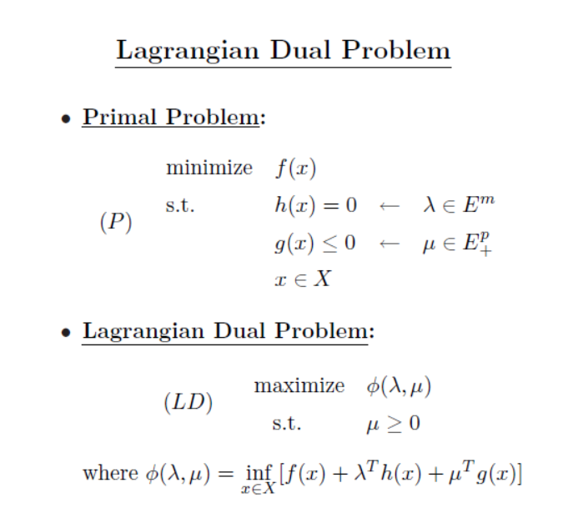
Notes:
去解lamda mu 得到最大化的sol
線性規劃

Slide 16
